Slide 2

The Virtual Road Trip
A Power Platform Story
Notes:
Photo by Dominika Roseclay: https://www.pexels.com/photo/person-wearing-beige-sweater-holding-map-inside-vehicle-1252500/

Slide 3


bit.ly/3fpjn5V

Slide 4
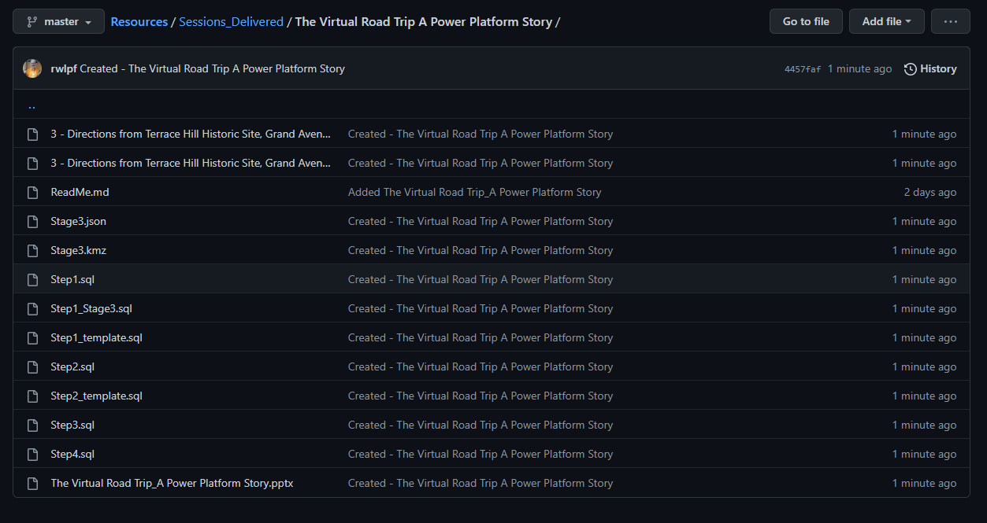

Slide 5


Slide 6

Notes:
Photo by Andrea Piacquadio: https://www.pexels.com/photo/cheerful-man-using-laptop-for-video-call-3799821/
In the middle of the pandemic when we were working from home
Do remember teams calls, zoom calls, remote meetings?

Slide 7


Slide 8
Employee owned

Slide 9

Notes:
Photo by Erik Mclean on Unsplash
So how could be encourage people to exercise?

Slide 10

James Frost had an idea

Slide 11


Slide 12


Slide 13
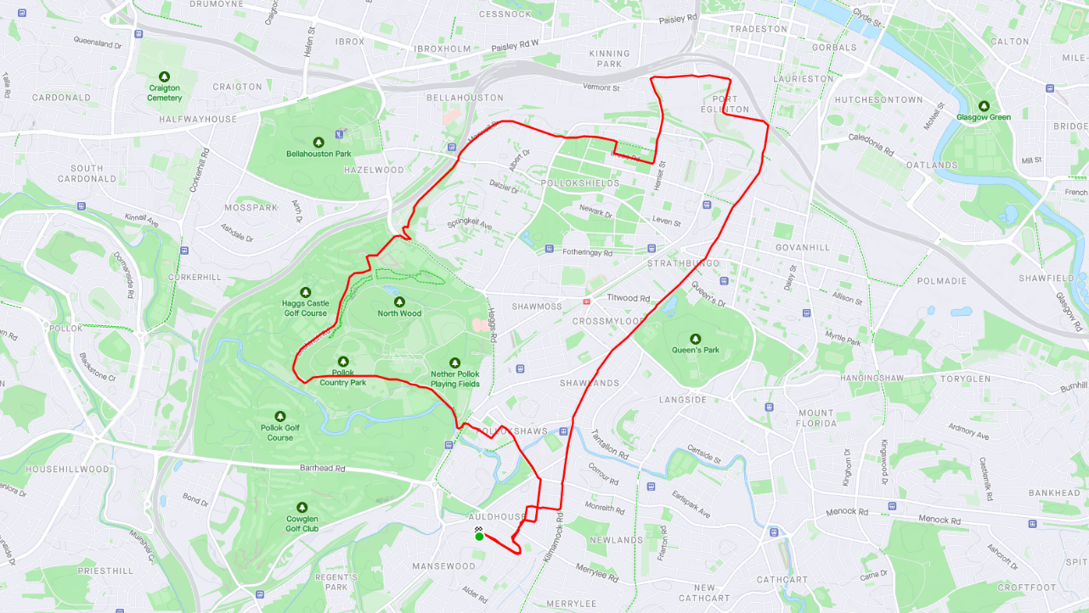

Slide 14
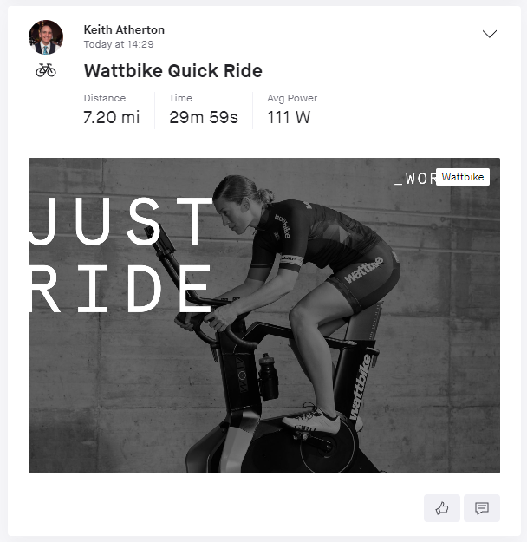
Notes:
And those who prefer to use exercise machines may also have the option to connect to Strava.

Slide 15


Slide 16




Slide 17

Notes:
https://tenor.com/view/magic-shia-la-beouf-gif-4410002

Slide 18
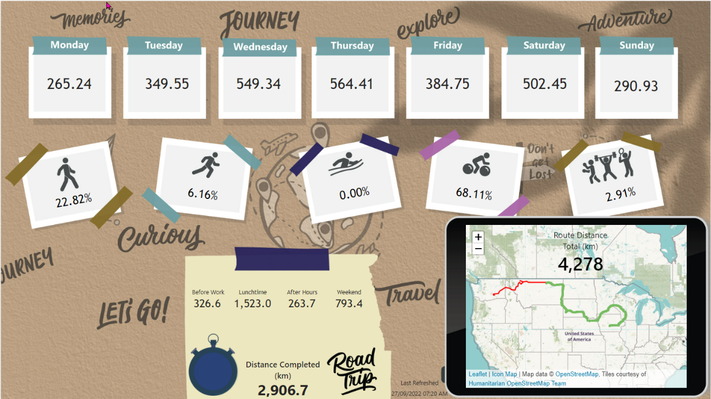

Slide 19

Notes:
Photo by Nick Seagrave on Unsplash
This project has been a journey

Slide 20

Notes:
Photo by Glenn Carstens-Peters on Unsplash
So what are we going to talk about?

Slide 21


Slide 22


Slide 23


Slide 24


Slide 25


Slide 26

Notes:
Photo by Marvin Meyer on Unsplash
What we have told is build by a team of people not one person
Also a number of different technologies

Slide 27


Slide 28

Not about this
Notes:
Photo by Jake Ingle on Unsplash

Slide 29




Notes:
Very often we only see 5% of a project. Often people are not aware of the huge amount of work that happens in the background to achieve results

Slide 30

Notes:
Photo by Sean Foster on Unsplash
We also might speak about some of the unexpected detours we encountered as we over came some challenges

Slide 31

Notes:
Photo by FORTYTWO on Unsplash
This project is like lego bricks we have taken small parts and combined them into one larger project

Slide 32

Notes:
Photo by Aedrian on Unsplash
We just combined them in different ways to create

Slide 33

Notes:
Photo by Phil Hearing on Unsplash
To make something unique yes not everyone will like it ☺

Slide 34

Notes:
Photo by Sebastian Herrmann on Unsplash
About the journey

Slide 35





Darren Phillips
Marketing Guru
Graphics Genius
Fantastic Barista
Darren.Phillips@qnrl.com
@DaristaBarista
linkedin.com/in/darrenphillips1984/
https://www.qnrl.com/

Slide 36


Keith Atherton
Power Platform Solution Architect
Microsoft MVP for Business Applications
Microsoft Certified Trainer (MCT)
Lives in Edinburgh, Scotland
[Not from there originally 🤫]
https://www.linkedin.com/in/keith-atherton/
@MrKeithAtherton
Notes:
My name is Keith Atherton, I'm a Senior Developer at Quorum and, like Rob, I also joined Quorum during the pandemic.
Most of my time is spent with the Power Platform, specifically Power Apps, Power Automate and anything that we think can help our clients.
My contact details are on screen now. Feel free to contact me directly after this session.
Rob, over to you.

Slide 37
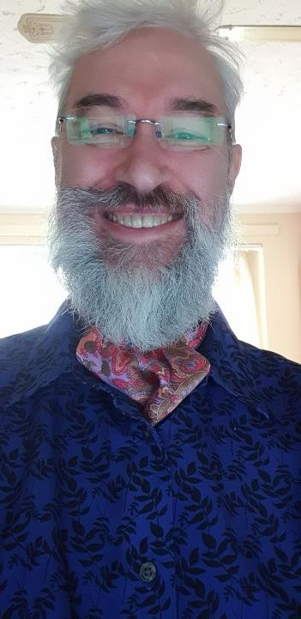


Robert French
Chief Power BI Nerd with Quorum
Power BI Nerd at Aggreko
Lives in Sunny Glasgow, Scotland
rwlp.french@gmail.com
@sqlbobscot.bsky.social
@SqlBobScot@techhub.social
https://www.linkedin.com/in/rwlpfrench/

Slide 38

Notes:
Photo by Suzy Hazelwood: https://www.pexels.com/photo/notebook-1226398/
What will we be talking about?

Slide 39

Notes:
Photo by Gia Oris on Unsplash
Start – how did we get started?

Slide 40
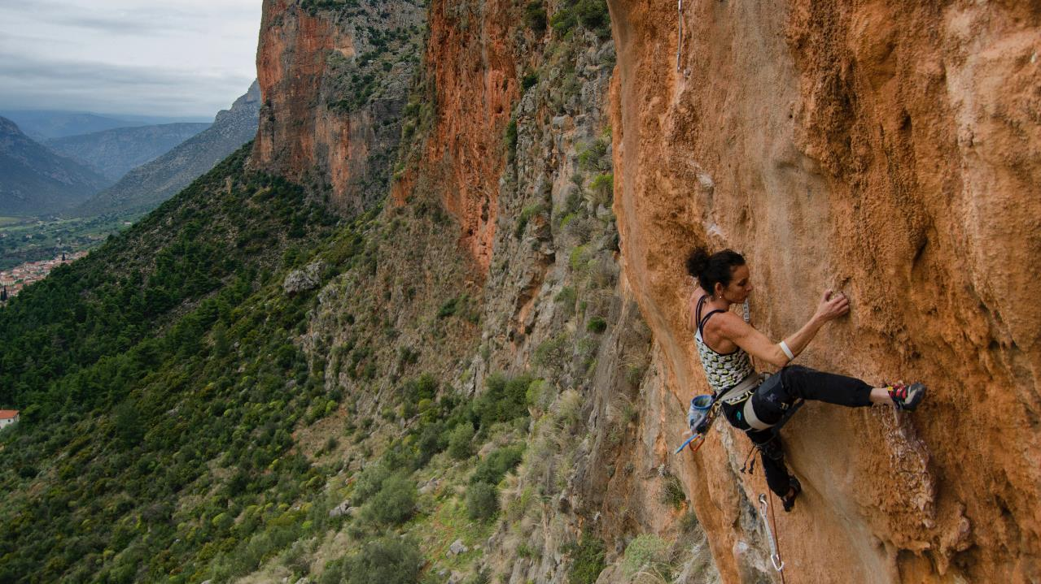
Notes:
Photo by Fionn Claydon on Unsplash

Slide 41

Notes:
Photo by Los Muertos Crew: https://www.pexels.com/photo/a-baker-making-a-cake-in-a-kitchen-8477963/
Adding icing to the cake

Slide 42

Notes:
Photo by Brett Jordan: https://www.pexels.com/photo/wood-typography-photography-blur-7939943/
Lets get started

Slide 43
Notes:
Photo by Gia Oris on Unsplash
Start – how did we get started?

Slide 44

“Robert your boss has told me you can work on this Power BI report idea..”

Slide 45

“That’s fantastic Darren, can you show me the idea?”

Slide 46
Dramatic pause
(my boss had to email to me)

Slide 47
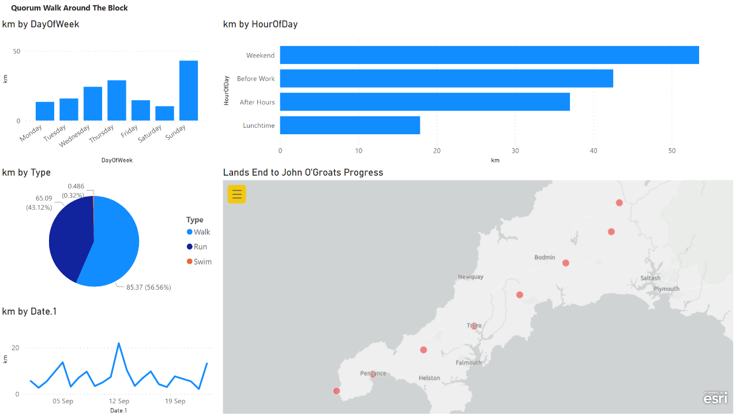
Notes:
This was v0.1

Slide 48

Notes:
Photo by Usman Yousaf on Unsplash
This was my reaction on seeing the report

Slide 49
Notes:
This was v0.1

Slide 50

Notes:
Photo by Brett Jordan on Unsplash
I reckoned with could do better

Slide 51
First
challenge

Slide 52

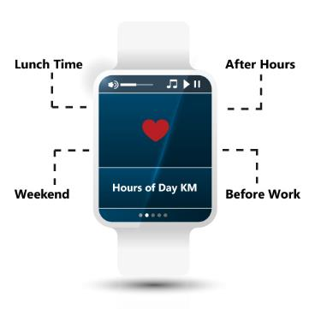



Slide 53

Notes:
So we talked about the layout had some conversations

Slide 54


Notes:
Darren had some ideas ! Following our conversations
Since Darren is not hear to talk them or defend the way I used his photo, then I can say what I like

Slide 55
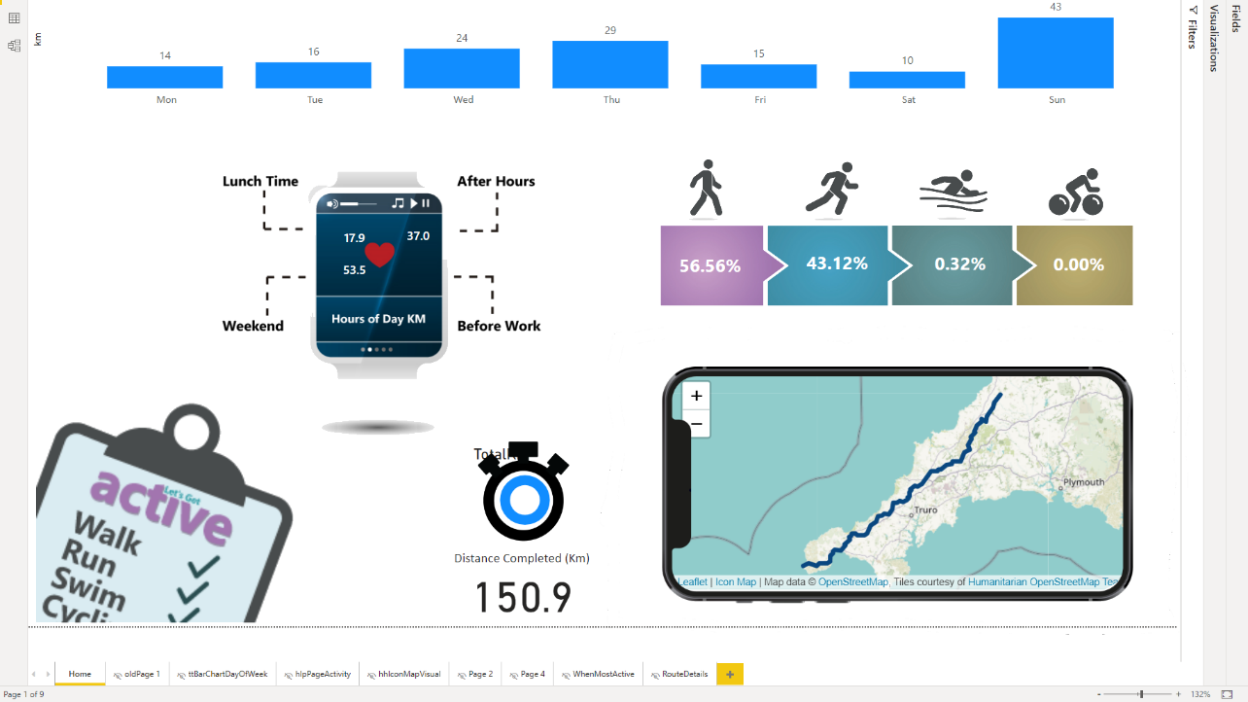

Slide 56

Darren says
Notes:
Photo by Florian Schmetz on Unsplash
Darren thought No

Slide 57

Notes:
Photo by fauxels: https://www.pexels.com/photo/colleagues-looking-at-survey-sheet-3183153/

Slide 58
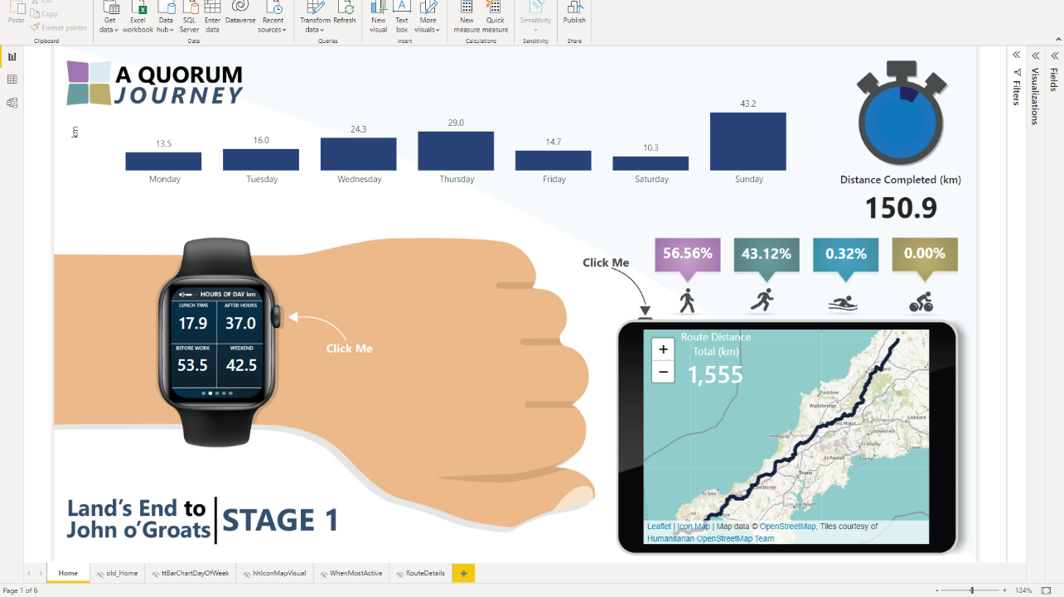

Slide 59
Now with added
Quorum-inmation
(animation)

Slide 60
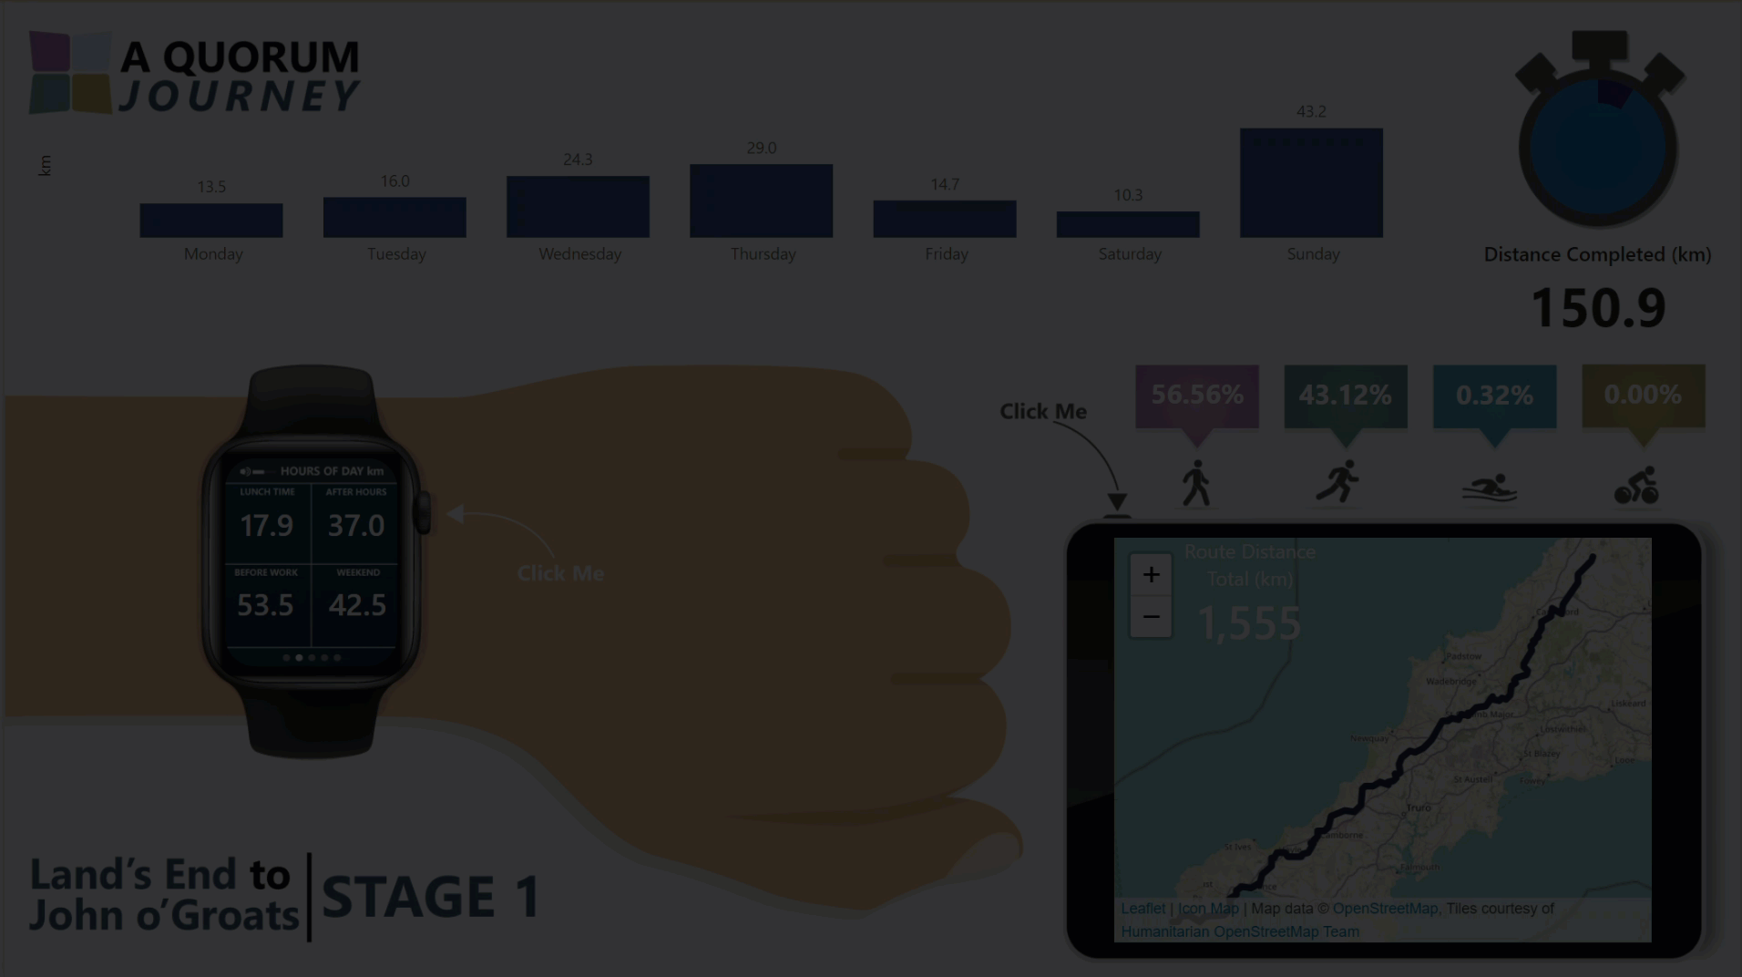

Slide 61

Notes:
Photo by Tim Mossholder on Unsplash

Slide 62

How ?
Notes:
Photo by Chris Arthur-Collins on Unsplash
How did they do that?

Slide 63

Notes:
So first how do we get the data into Azure Data Factory?

Slide 64
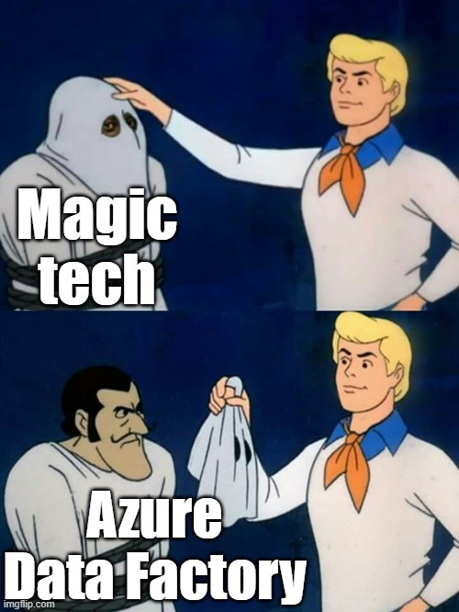



Slide 65
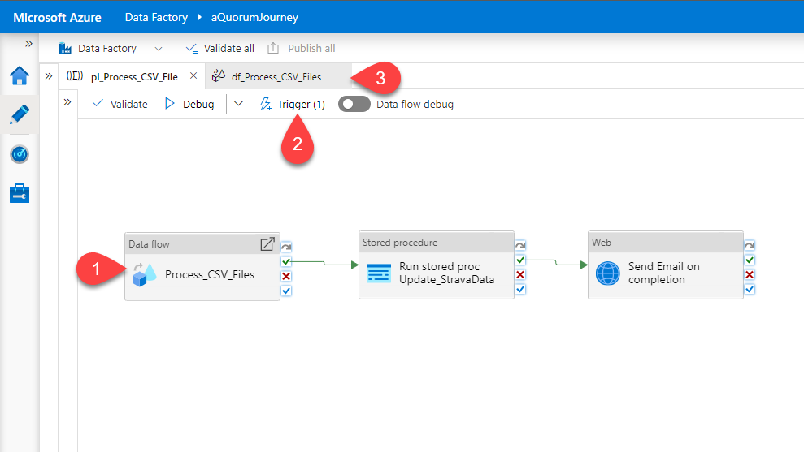

Slide 66
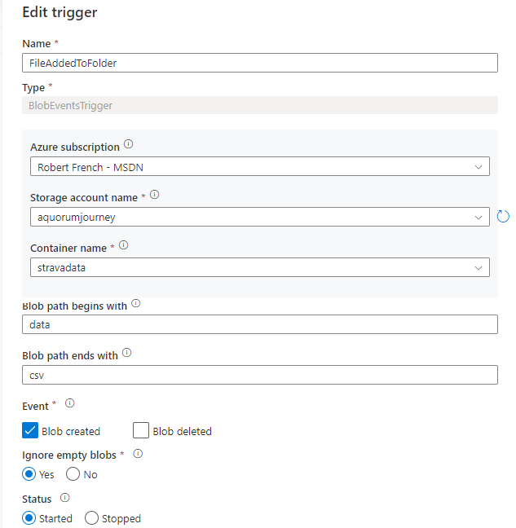


Slide 67

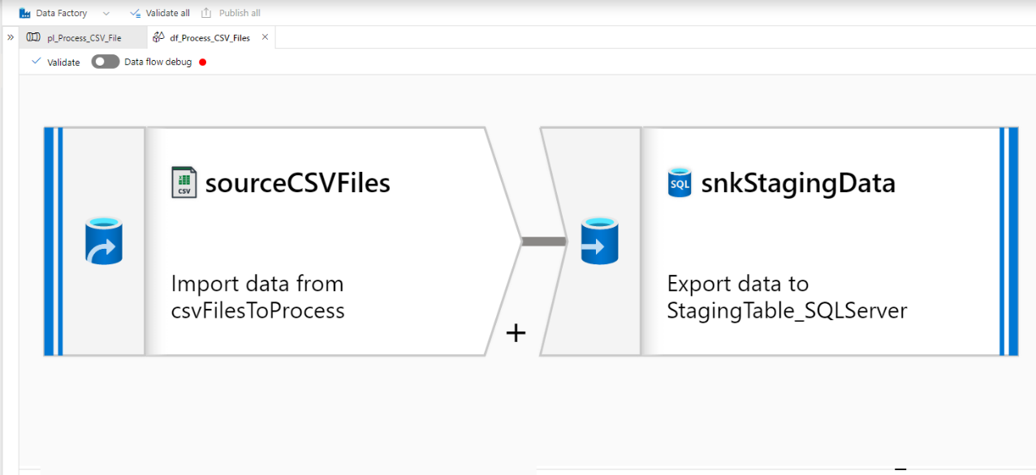

Slide 69
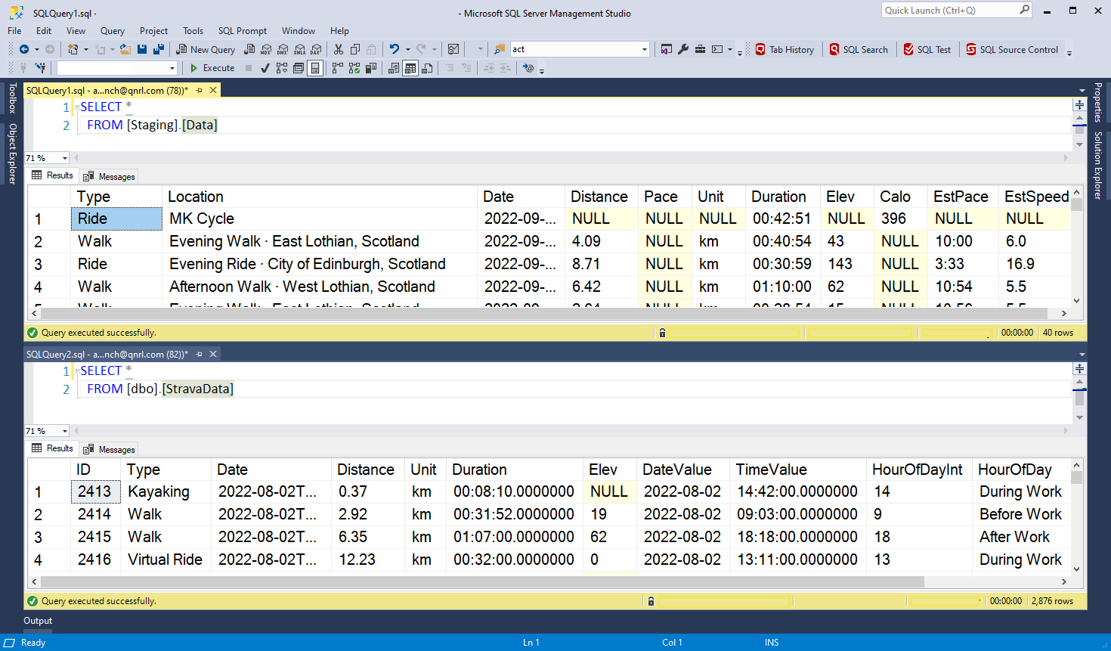

Slide 70

Notes:
Photo by Miikka Luotio on Unsplash
Yawn not very exicting we agree
Simple can be good though

Slide 71
Second challenge

Slide 72
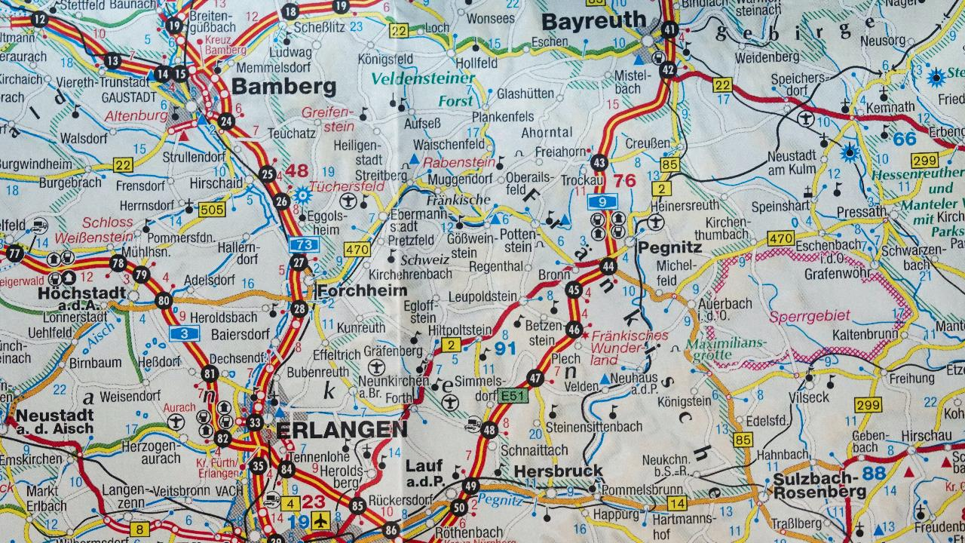
Notes:
Photo by Thomas Kinto on Unsplash
The route

Slide 73
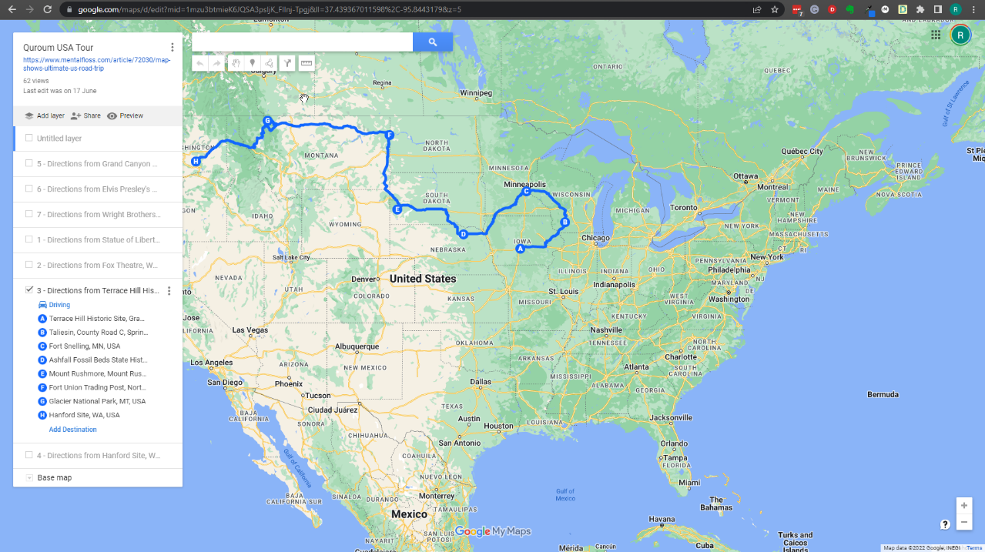

Slide 74

Notes:
This was great !

Slide 75


Slide 76
Notes:
Photo by Sean Foster on Unsplash
Bit of detour

Slide 77

Notes:
Photo by Usman Yousaf on Unsplash
However it could not be imported in SQL Server.

Slide 78
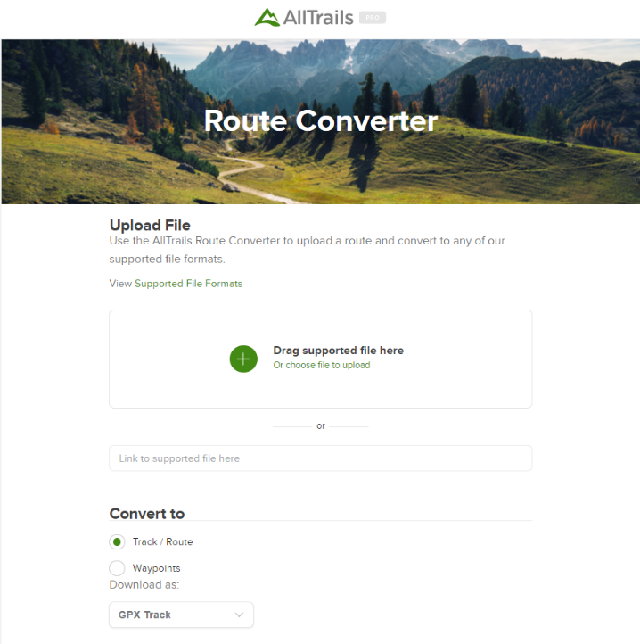

Slide 79
This will produce a ‘SQL script’ like this one
#CREATE TABLE tracks (
# fileId VARCHAR(16) NOT NULL,
# idx INT NOT NULL,
# lat DOUBLE NOT NULL,
# lon DOUBLE NOT NULL,
# ele DOUBLE NULL,
# PRIMARY KEY (fileId, idx)
#);
INSERT INTO tracks (fileId, idx, lat, lon, ele) VALUES ('null', '1', '42.33876000', '-83.0525900', '190.0');
INSERT INTO tracks (fileId, idx, lat, lon, ele) VALUES ('null', '2', '42.33762000', '-83.0552800', '184.0');
INSERT INTO tracks (fileId, idx, lat, lon, ele) VALUES ('null', '3', '42.33822000', '-83.0557500', '180.0');
INSERT INTO tracks (fileId, idx, lat, lon, ele) VALUES ('null', '4', '42.33833000', '-83.0558200', '180.0');
INSERT INTO tracks (fileId, idx, lat, lon, ele) VALUES ('null', '5', '42.33839000', '-83.0558500', '180.0');
INSERT INTO tracks (fileId, idx, lat, lon, ele) VALUES ('null', '6', '42.33855000', '-83.0559600', '182.0');
INSERT INTO tracks (fileId, idx, lat, lon, ele) VALUES ('null', '7', '42.33875000', '-83.0561600', '183.0');

Slide 80
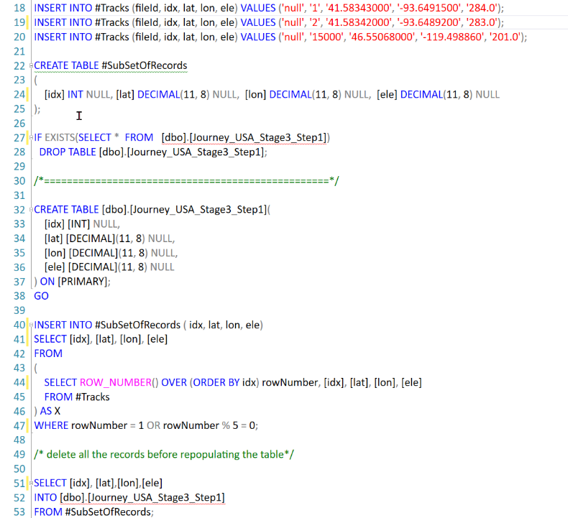
Notes:
Reduce the number of points by only selecting 1 out of 5

Slide 81
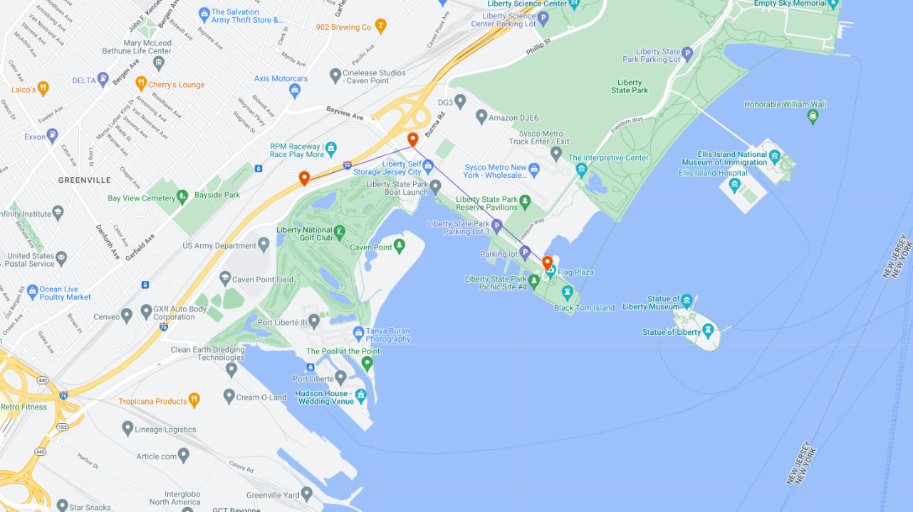
?
?

Slide 82


Slide 83

Notes:
Photo by Pixabay: https://www.pexels.com/photo/scientific-calculator-on-wooden-surface-220301/

Slide 84


Slide 85
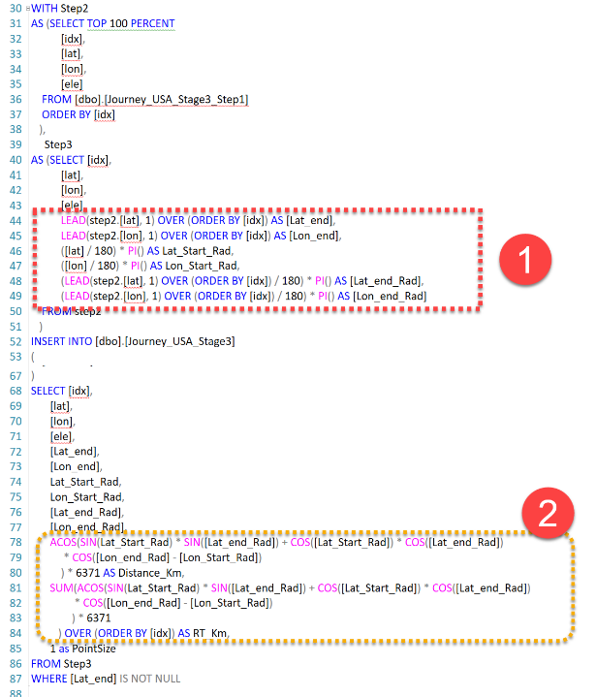

Slide 86
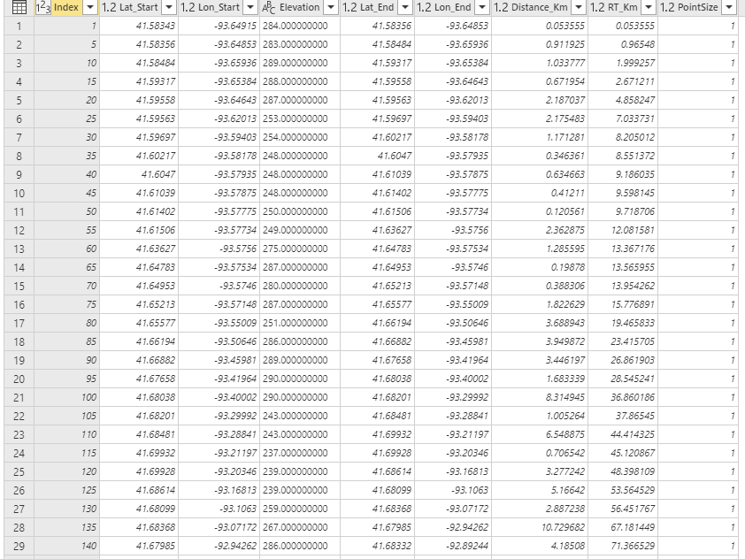
Distance from Starting Point to End Point
= 2.2 KM
Total distance to the End Point = 23.4 KM

Slide 87
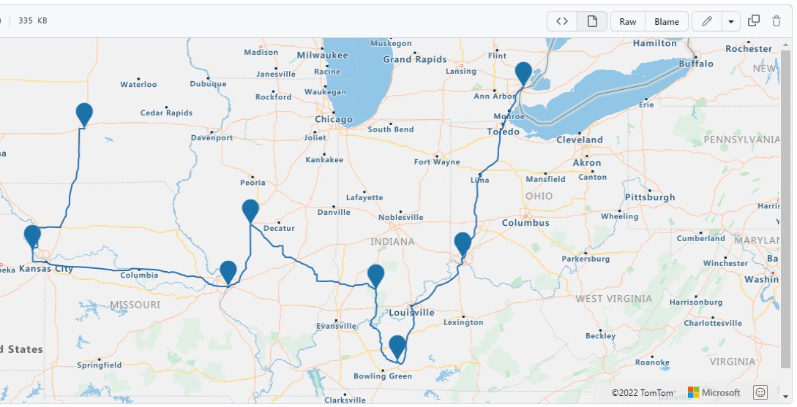
Notes:
From the gpsx file created a GEOJESON file

Slide 88
What do you get?

Slide 89
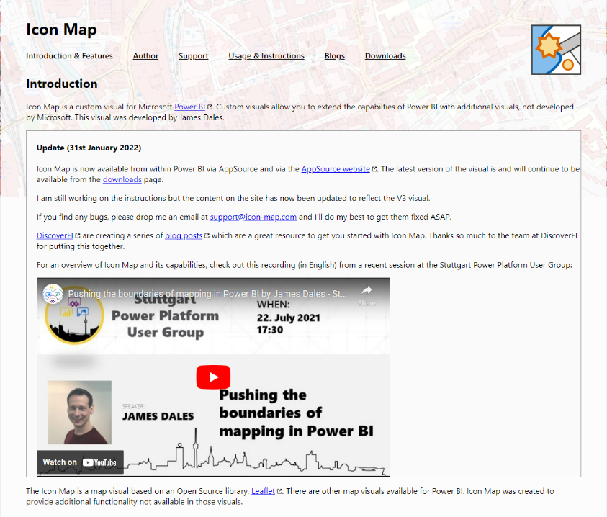
https://icon-map.com/

Slide 90
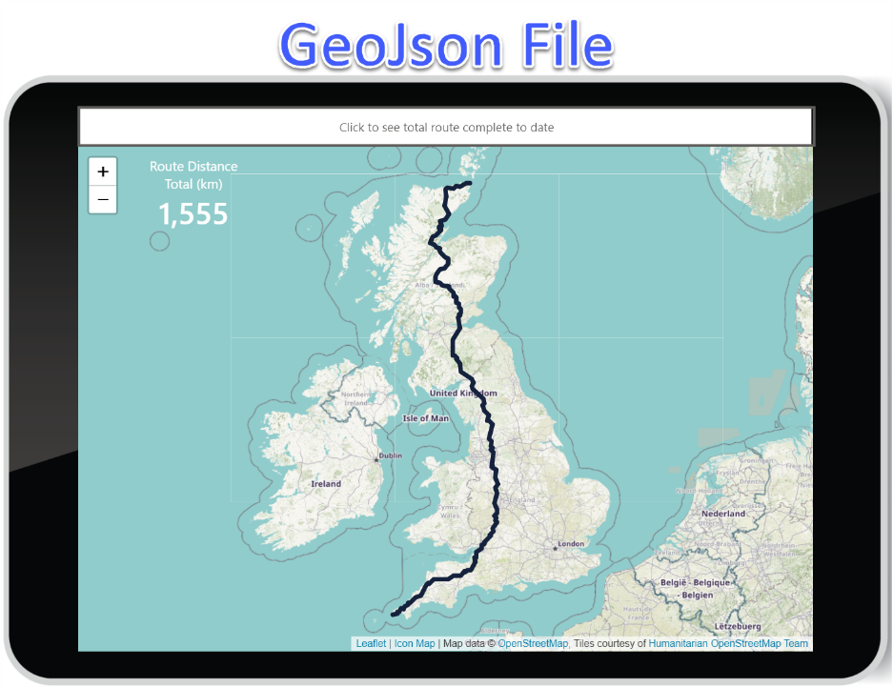
Notes:
GeoJson file to show the journey we are taking

Slide 91
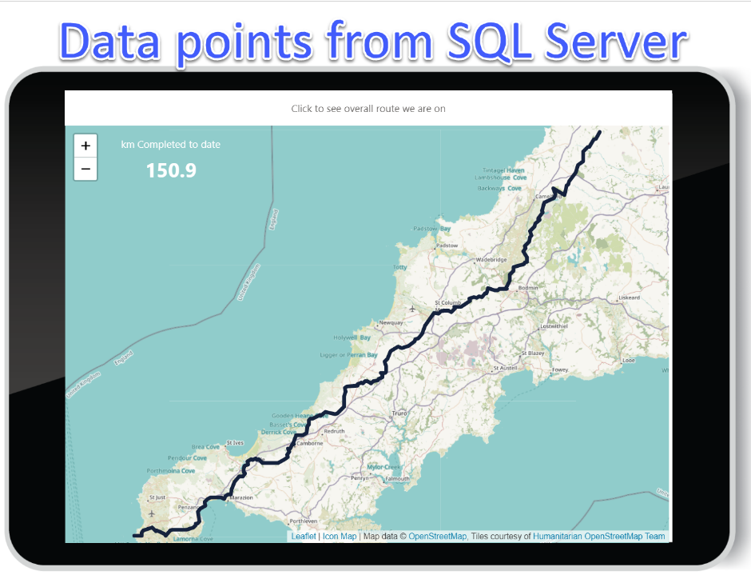
Notes:
This shows how far along the route we have managed to get?

Slide 92

V2.?

Slide 93
Notes:
Photo by Sean Foster on Unsplash
We also might speak about some of the unexpected detours we encountered as we over came some challenges

Slide 94


Slide 95
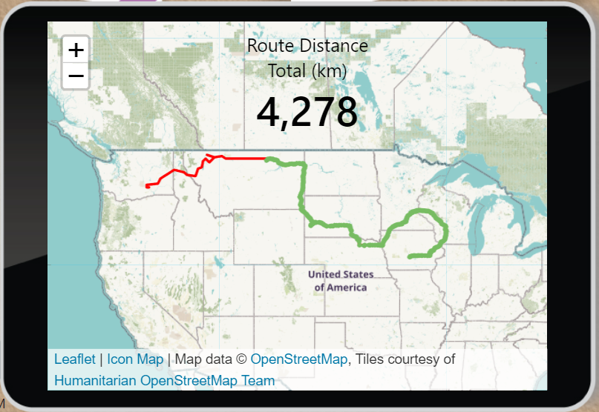
Overall
Route
(to complete)
Route
Completed

Slide 96

Notes:
Photo by MART PRODUCTION: https://www.pexels.com/photo/tired-man-touching-his-eyes-7255264/
Yes Robert did miss the memo about accessibility and colour blindnesses

Slide 97
Notes:
Photo by Los Muertos Crew: https://www.pexels.com/photo/a-baker-making-a-cake-in-a-kitchen-8477963/
Adding icing to the cake

Slide 98
“Power Automate is amazing!
I have an idea…..”

Slide 99
“Ok…..
What’s the idea?”

Slide 100
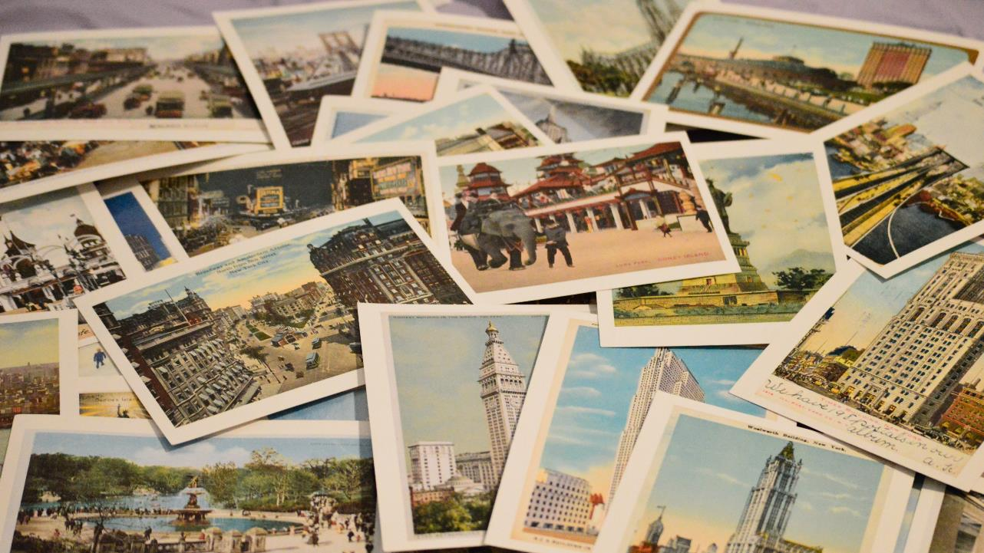
Notes:
Photo by Becky Phan on Unsplash

Slide 101


Slide 102
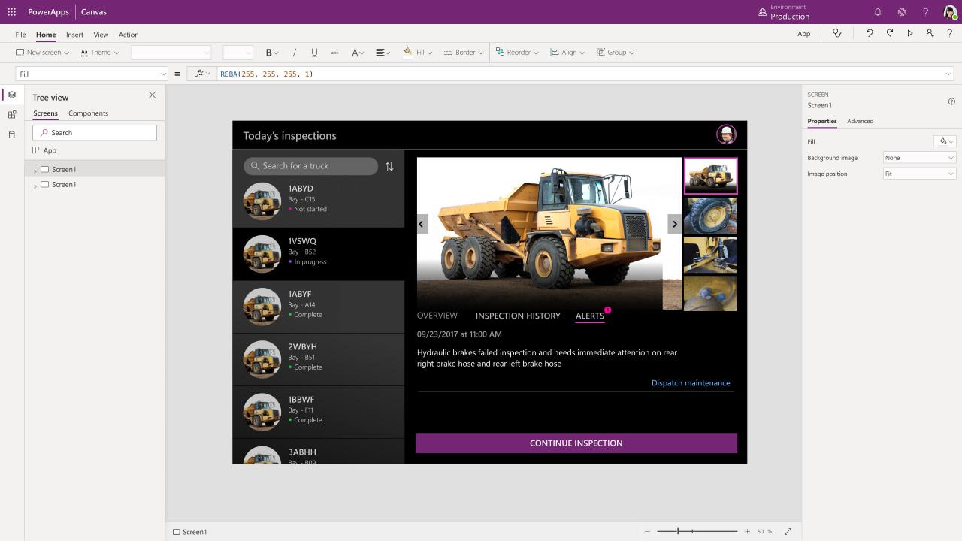
Notes:
Thanks Rob.
Hands up who knows what a Power App is.
And hands up who has experience of developing a Power App.
Great. For those who don’t know, Power Apps are low code/no code tools so people with no coding experience can create apps.
They can be created in the browser using click-and-drag tools and by setting property values like fonts, colours, etc.

Slide 103
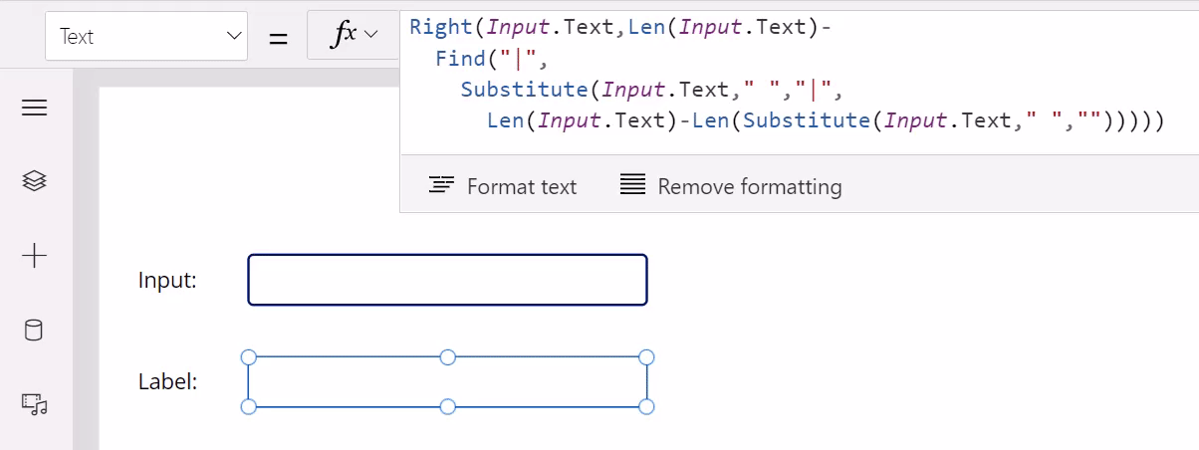
Notes:
And you can use a simple programming language called Power Fx, similar to Excel formulas.

Slide 104
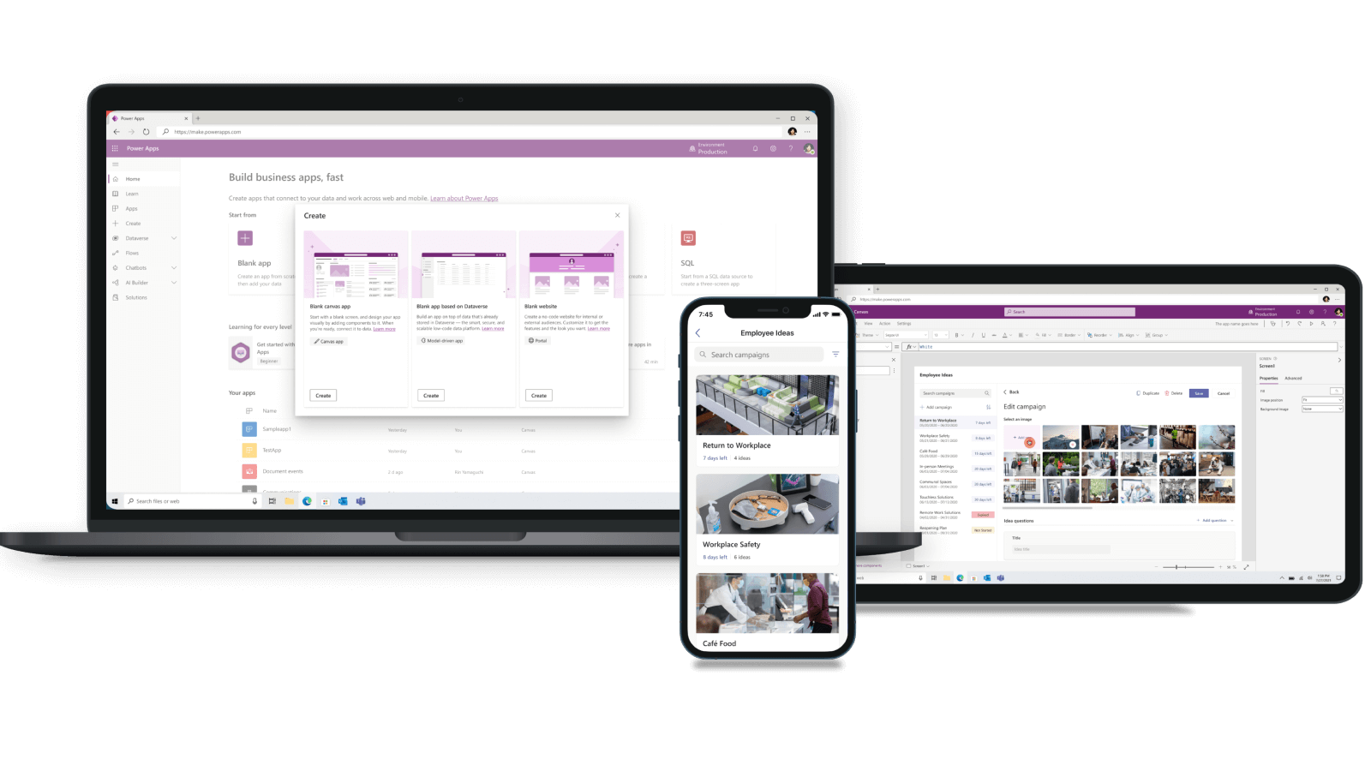
Notes:
Power Apps are really just web apps under the bonnet, and they can be usable on Desktop, tablet, and mobile devices.
Non-coders who develop Power Apps are sometimes referred to as “Citizen Developers” or “Citizen Makers”.
And when Citizen Developers (like Darren) and Pro Developers (like myself) work together, it’s sometimes referred to as “Fusion Development”, which is what’s been the case on this project.

Slide 105
Darren created this!
Notes:
So, as you can see, Darren the Marketing Wizard and Rob the Data Guru have done all this amazing work, and now have a working Power App.

Slide 106

Notes:
So, game over, right? Why would we need a coder?
The Power Platform has allowed non-coders to create an awesome app.
As you saw, the UI looks great…

Slide 107

Notes:
And you wouldn’t typically want a coder to design the UI.

Slide 108

Notes:
And Rob has done all this amazing data and Power BI reporting.
So, how can I help?

Slide 109

But we need it to be interactive…
Notes:
Well, one thing a coder can help with is: Making things interactive, data-driven and reusable.
The app contains multiple stages and each stage contains multiple USA states – this one is for Stage 3 which contains 8 states.
When clicking one of the state buttons, the postcard screen for that state would be shown, filling the screen.

Slide 110
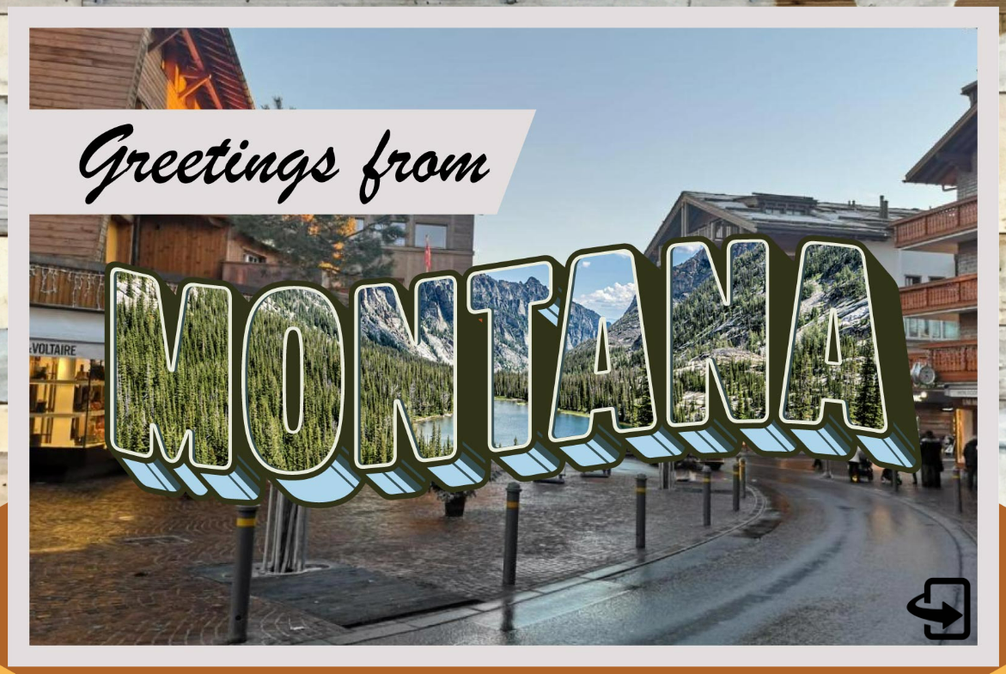
Notes:
Here’s Montana as an example. So far, so good, right?

Slide 111
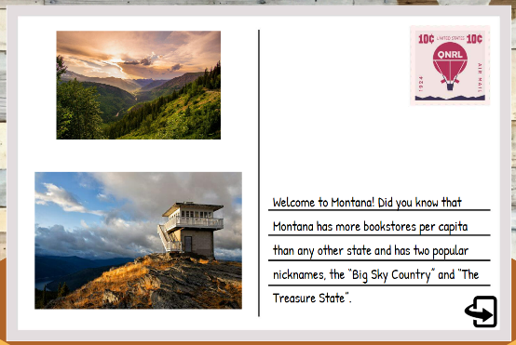
Notes:
Here’s Montana as an example. So far, so good, right?

Slide 112
Each button has been added individually…
Notes:
However, back on this main screen, Darren has been adding each state button one-by-one.
So, if we change the logic behind one button click, we have to change the logic behind all buttons for all stages!
Also, if we want to change the button format like the size, image, text, etc then, again, we have to change all buttons for all stages!

Slide 113

Notes:
Poor Darren. We like Darren so we don’t want him to be doing this the hard way…
We needed a way to make this more reusable.

Slide 114
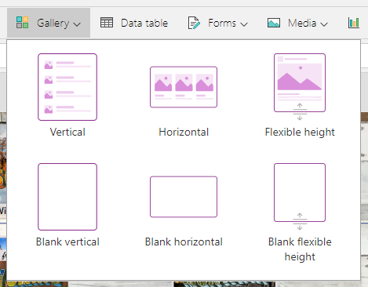
Notes:
The solution we used was to use a Gallery control.
This works like a Grid or ListView control where you connect it to a data source, such as a table or view, and rows are repeated so it’s now data-driven.
So, when Darren now changes the gallery primary cell format, all postcard buttons are changed at the same time.
Much more efficient for Darren!

Slide 115

Each postcard needs front and back screens…
Notes:
Also, initially the app had two postcard screens for each of the 48 states:
One for the front (on the left) + one for the back (on the right).
So, New York Front, New York Back, California Front, California Back - you get the point.
So, 48 states front + back means 96 screens!

Slide 116

Notes:
96!
Again, we needed to make things more reusable so Darren wouldn’t explode.

Slide 117
PostcardFrontImage
PostcardFlippedImage1
PostcardFlippedImage2
PostcardFlippedText
Notes:
So, to make life easier, I created a couple of reusable postcard template screens:
A “Postcard Front” template screen (on the left) and swapped out the main image depending on the state selected.
And a “Postcard Back” template screen (on the right) which has two smaller images on the left and a block of text on the right.
This was done by setting variables after clicking the state button on the main screen as we know, at that point, which state has been clicked.
This is now also reusable and much more efficient.

Slide 118
Each postcard needs 3 modes…
Notes:
Another key feature was to have three modes for each postcard button on the main screen.

Slide 119
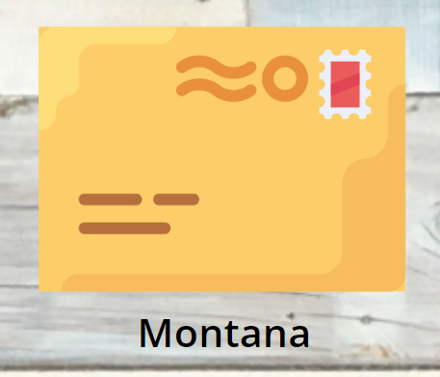
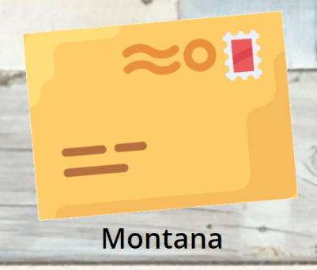
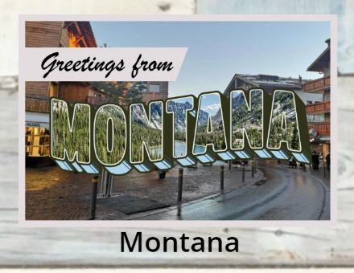
Notes:
- Locked (on the left): a static envelope image.
- Unlocked (in the centre): an animated envelope image.
- And opened (on the right): a postcard thumbnail image.
So, we needed logic to reflect these modes.
Darren isn’t a developer (and doesn’t want to be a developer) so I was able to help with some Power Fx code.

Slide 120
If(
Lower(Text(LookUp(UserInfo, EmailAddressState = User().Email & "-" & ThisItem.State, PostcardOpened))) = "true",
"appres://resources/" & Substitute(ThisItem.State, " ", "") & "Front",
If(
StravaTotalDistanceKm >= Value(ThisItem.DistanceKm),
EnvelopeLarge,
EnvelopeStatic
)
)
Notes:
To achieve this, code was placed on the gallery cell to show the appropriate image.
So, if the state distance – in this case, Montana – was further than our Strava-recorded distance, then the postcard would be "locked“ because we’ve not yet reached the state.
However, if a state has been reached, that postcard button is “unlocked” and showing the animated envelope image.
And if we then open a state’s postcard, the state’s thumbnail image is shown.
Also, when a postcard is opened, that action is stored in the database for that user.
That means the postcard button will now show a postcard thumbnail image on the main screen going forward.
Having this user data stored centrally in the database means that the postcard thumbnail image will show on any device running the app.
That’ll give the user a consistent experience no matter where they access the app from.

Slide 121
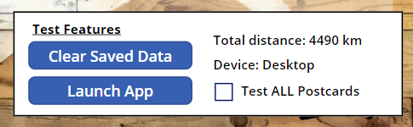
Notes:
We also came up with some "nice touches“.
One of them was “Test Features” to show information like total distance logged and debug options like being able to test all postcards.
These options are shown for us “developers” only (so, Darren, Rob, and myself) so we could test the app.

Slide 122

Notes:
I implemented this by adding these “Test Features” controls and setting the Visible property to True if the user accessing the app was Darren, Rob or myself.

Slide 123
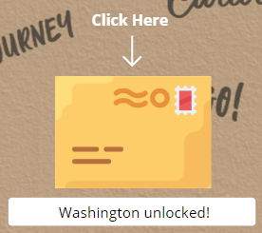
Set(StravaTotalDistanceKm, Value(First(StravaTotalDistance).DistanceKm));
Set(StatesAvailable, Filter(StateInfo, StravaTotalDistanceKm >= Value(DistanceKm)));
Set(FurthestState, First(Sort(StatesAvailable, Value(DistanceKm), SortOrder.Descending)).State);
Set(StateUnlockedMessage, If(!IsBlank(FurthestState), FurthestState & " unlocked!", "Go to states!"));
Notes:
And finally, setting button text to specify the most-recent state unlocked.
This was done by using a formula based on the total distance logged, which is shown at the bottom there.
Again, the code itself isn’t important, this is more about how it works from a high level.

Slide 124
What else could I bring to the table…
Notes:
There were other useful features under the bonnet too such as using concurrency when retrieving data for good performance.
And things like reusable methods to avoid duplication of effort throughout the app.
So, in summary, most of the Power App development that I did was to make it interactive, data-driven and as reusable as possible.
This meant that Darren in Marketing could work on the app more efficiently and not have to worry about things like writing code or managing data access.
Darren could then concentrate on important things like the user experience, layout and these awesome graphics.
Rob, back to you.

Slide 125


Slide 126
This is Darren
He is NOT a developer
Notes:
Yes Darren did let me say that ☺

Slide 127

Notes:
Photo by Randy Tarampi on Unsplash

Slide 128
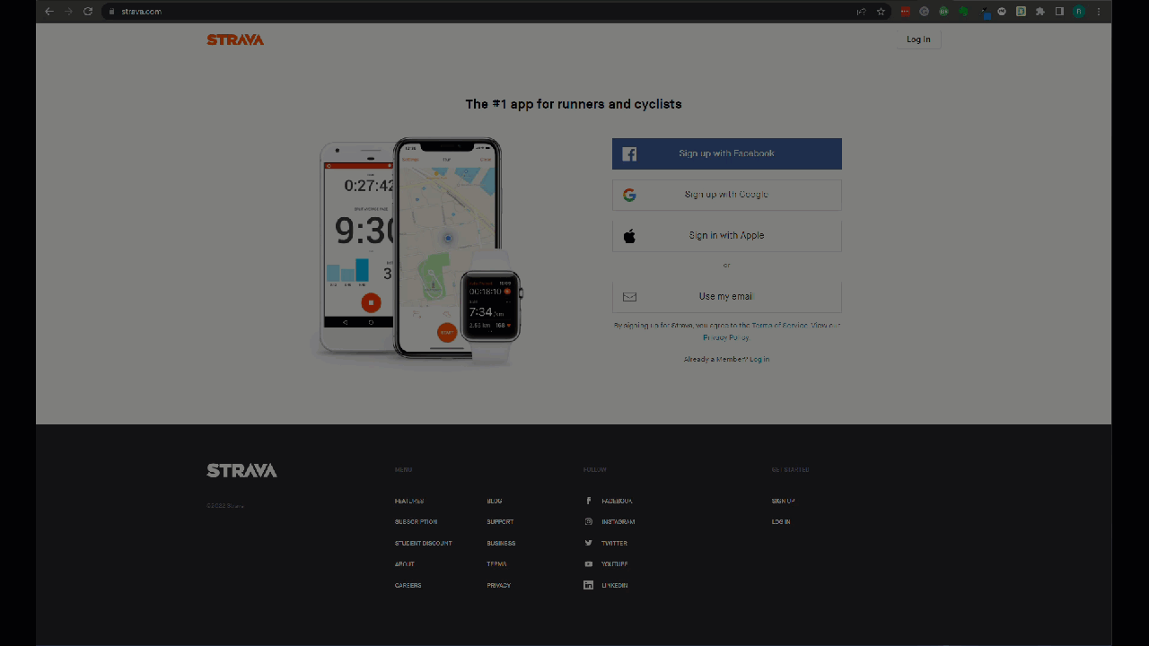

Slide 129

Zero
Notes:
Photo by Hitesh Choudhary on Unsplash

Slide 130
Remember he is NOT a developer
(PS he is very happy about that)
Notes:
Yes Darren did let me say that ☺

Slide 131

Notes:
Photo by Matt Ridley on Unsplash

Slide 132


Slide 133

Notes:
What was the solution?

Slide 134


Slide 135
Logs into Strava
Downloaded file
To folder on desktop
Removes “comma”
Launches azure blob

Slide 136


Slide 137

ED?
Notes:
Photo by david Griffiths on Unsplash

Slide 138

Notes:
Photo by Monica Silvestre: https://www.pexels.com/photo/brown-broom-and-white-plastic-bucket-3562689/
Still not finished yet!

Slide 139
This is past Robert
He was not efficient

Slide 140
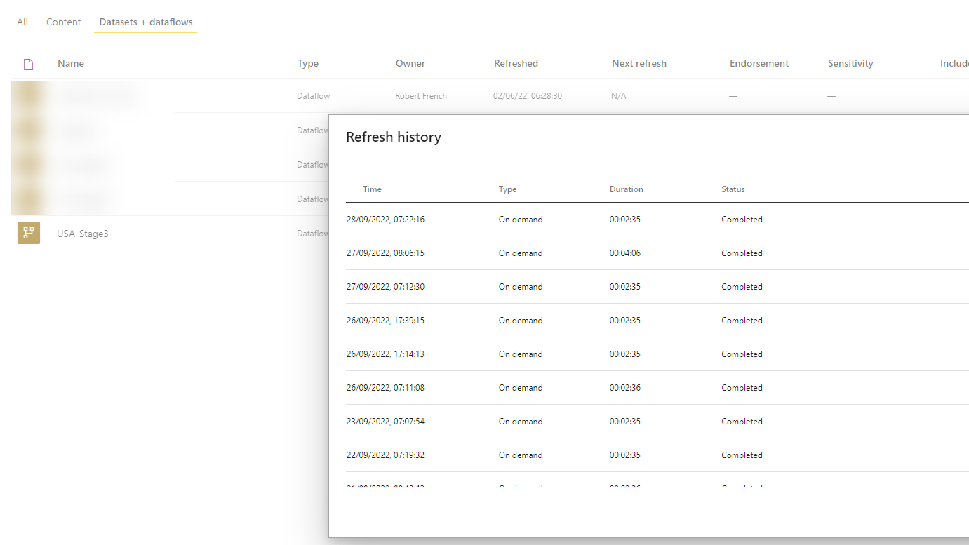
Notes:
Robert manually refreshed the DataFlow and Datasets each day

Slide 141

Notes:
Photo by Matthew Henry on Unsplash
This was sad

Slide 142
Notes:
Photo by Sean Foster on Unsplash
We also might speak about some of the unexpected detours we encountered as we over came some challenges

Slide 143
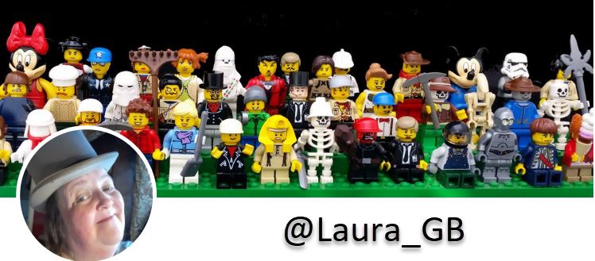
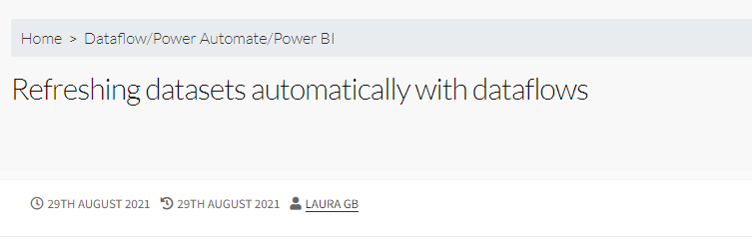
https://hatfullofdata.blog/refreshing-datasets-automatically-with-dataflows/

Slide 144

Notes:
Photo by Marcel Eberle on Unsplash

Slide 145
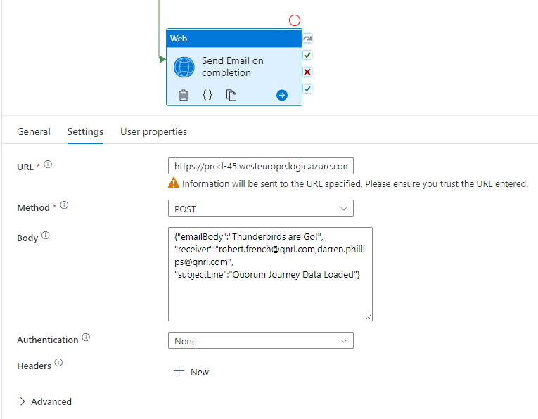
Notes:
In ADF send email so could be processed by

Slide 146
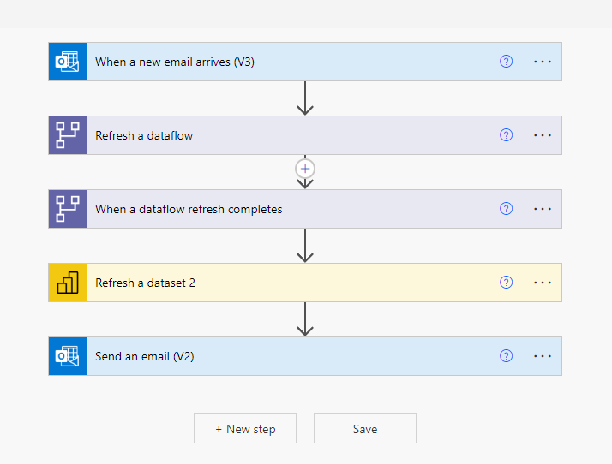

Slide 147





Slide 148


Slide 149
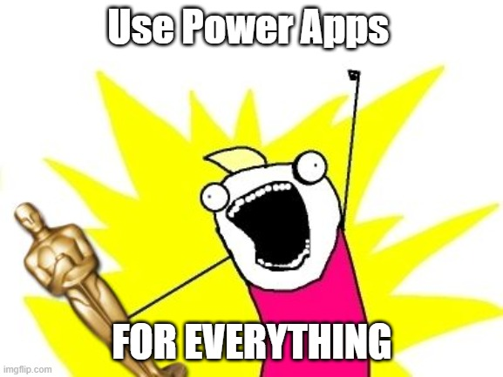
Notes:
I felt like this !

Slide 150

Notes:
Photo by Brett Jordan on Unsplash
Felt a little chaotic

Slide 151

Notes:
Photo by todd kent on Unsplash
Whilst it worked did feel messy

Slide 152

Notes:
Photo by Waldemar Brandt on Unsplash

Slide 153
Notes:
Photo by Sean Foster on Unsplash
We also might speak about some of the unexpected detours we encountered as we over came some challenges

Slide 154

Notes:
Photo by Nicolas Houdayer on Unsplash
One whilst day dreaming and looking a solution for a client noticed something about Azure Logic Apps

Slide 155


Slide 156
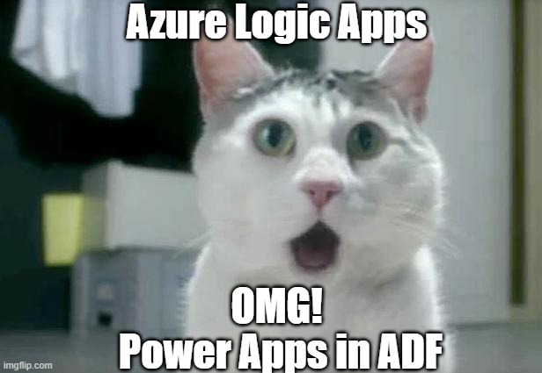
Notes:
Yes I know its not Power Apps in ADF

Slide 157
Notes:
Last step in the ADF pipeline was to send an email (organ

Slide 158
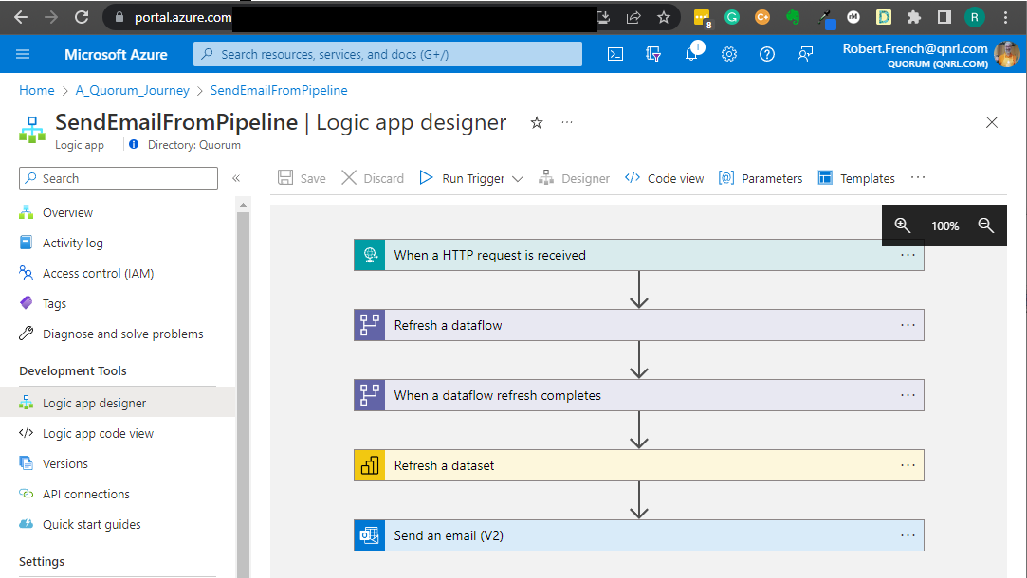

Slide 159
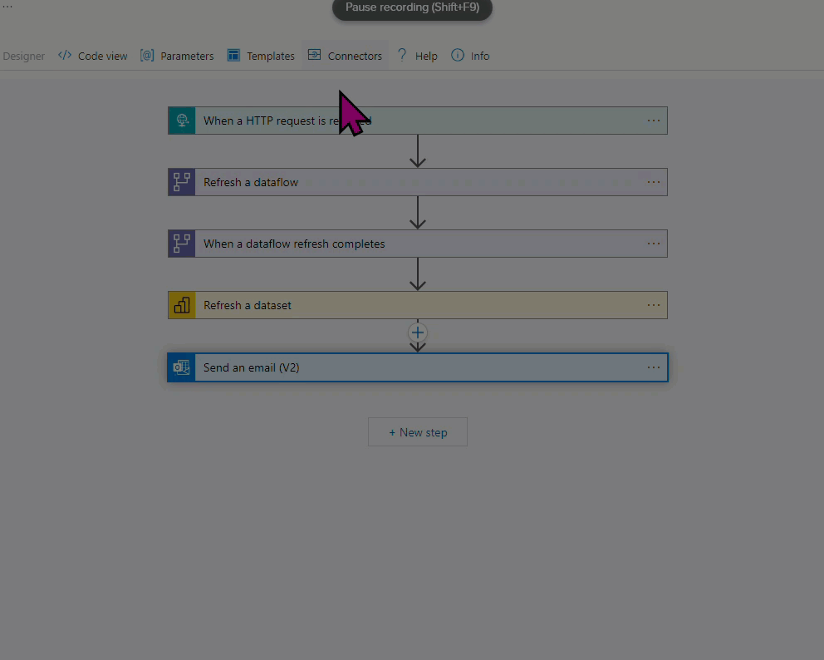

Slide 160


Slide 161

TLDL
(Too Long, Didn't Listen)
Notes:
Photo by Kelly Sikkema on Unsplash

Slide 162

Notes:
Photo by Jozsef Hocza on Unsplash
What are the key

Slide 163

Notes:
Photo by Clem Onojeghuo on Unsplash
What at the key takeaways?

Slide 164


Slide 165

Notes:
Photo by Nathan Dumlao on Unsplash
Ask for help if you do not know ask

Slide 166

Notes:
Photo by Brett Jordan on Unsplash
Help others show them what you have done , share your knowledge

Slide 167
Notes:
Photo by FORTYTWO on Unsplash
This project is like lego bricks we have taken small parts and combined them into one larger project

Slide 168
Notes:
Photo by Phil Hearing on Unsplash
To make something unique yes not everyone will like it ☺

Slide 169

Notes:
Photo by Nick Fewings on Unsplash
Teamwork

Slide 170

Notes:
Photo by Hannah Busing on Unsplash
Credit to some other members of the team

Slide 171

Credits
Tom “@SQLTomato” Skyes
ADF assistance
General good guy
Name of the project.

Slide 172


Credits
James Dales
The amazing dev who created Icon Map!
Icon-map.com

Slide 173
Laura Graham-Brown
Sharing ideas, and inspiration

Slide 174
Darren Phillips
Marketing Guru
Graphics Genius
Fantastic Barista
Darren.Phillips@qnrl.com
@DaristaBarista
linkedin.com/in/darrenphillips1984/
https://www.qnrl.com/

Slide 175
Keith Atherton
Power Platform Solution Architect
Microsoft MVP for Business Applications
Microsoft Certified Trainer (MCT)
Lives in Edinburgh, Scotland
[Not from there originally 🤫]
https://www.linkedin.com/in/keith-atherton/
@MrKeithAtherton
Notes:
My name is Keith Atherton, I'm a Senior Developer at Quorum and, like Rob, I also joined Quorum during the pandemic.
Most of my time is spent with the Power Platform, specifically Power Apps, Power Automate and anything that we think can help our clients.
My contact details are on screen now. Feel free to contact me directly after this session.
Rob, over to you.

Slide 176
Robert French
Chief Power BI Nerd with Quorum
Power BI Nerd at Aggreko
Lives in Sunny Glasgow, Scotland
rwlp.french@gmail.com
@sqlbobscot.bsky.social
@SqlBobScot@techhub.social
https://www.linkedin.com/in/rwlpfrench/

Slide 177

Notes:
Photo by ROCKETMANN TEAM: https://www.pexels.com/photo/persons-doing-a-thumbs-down-9486688/

Slide 178

Notes:
Photo by William Fortunato : https://www.pexels.com/photo/unrecognizable-multiracial-guys-showing-thumbs-up-gesture-6140709/

Slide 179
bit.ly/3fpjn5V

Slide 180


Slide 181

Notes:
Photo by Katrina Wright on Unsplash

Slide 182
bit.ly/3fpjn5V

Slide 183

Notes:
Photo: https://unsplash.com/photos/oZuBNC-6E2s

